Slide 1
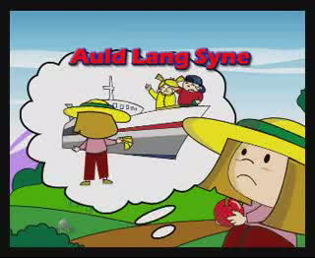

Slide 2
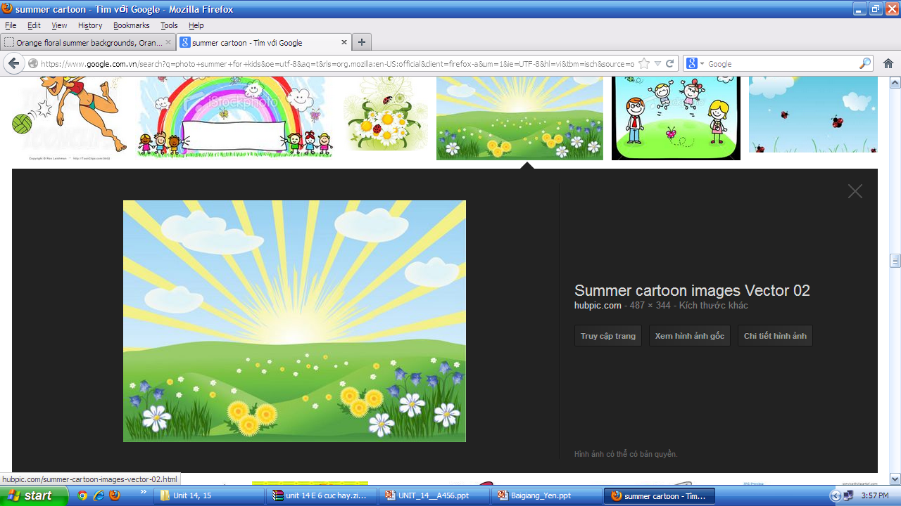






Welcome to English class !

Slide 3
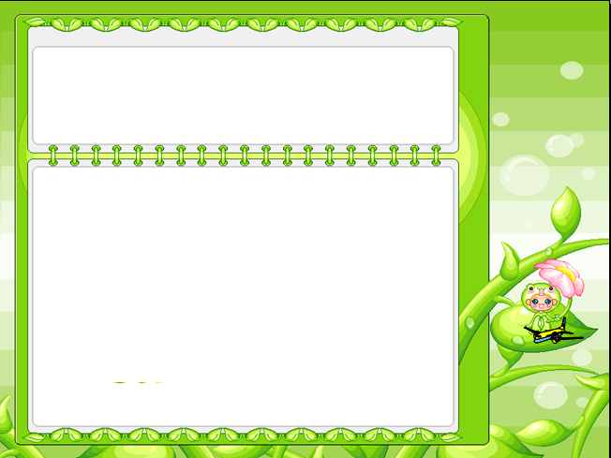
WARM UP
GUESSING GAME

Slide 4
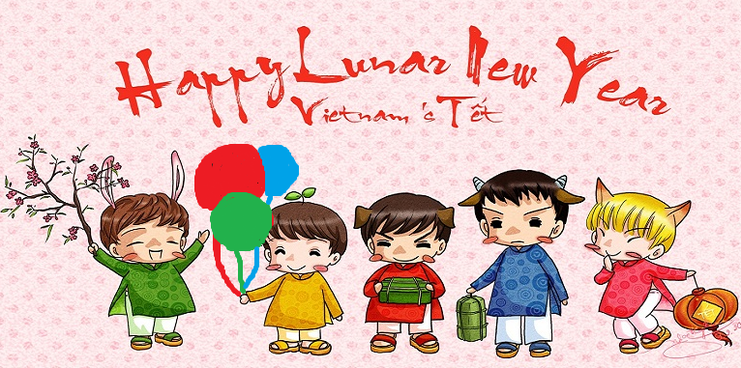

Unit 6:
?2
?1
Our Tet Holiday
Period 46- Lesson 2:
?3
?4
A closer look 1

Slide 5

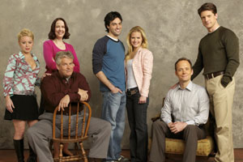
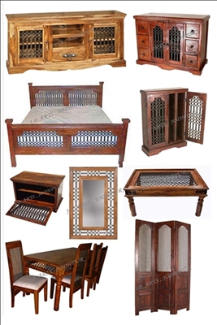
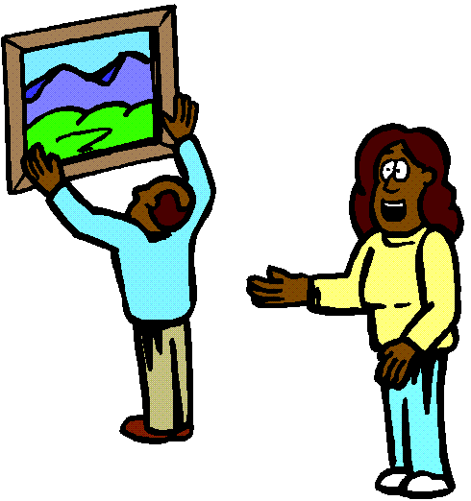
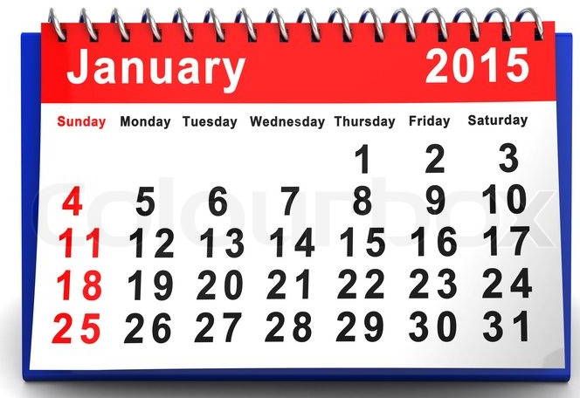
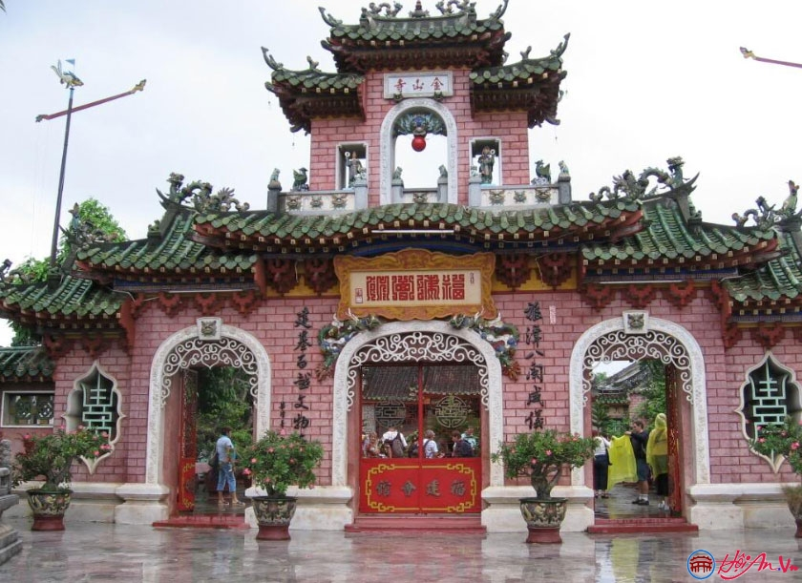
New words
1. (a) relative
['relətiv]
: họ hàng
2. furniture (unc)
['fə:nit∫ə]
: đồ nội thất
3. (a) calendar
['kælində]
: lịch
4. (a) pagoda
[pə'goudə]
: chùa
5. (to) hang
[hæη]
: treo, móc

Slide 6
Listen and repeat
Wish
Fireworks
Furniture
Present
Shopping
Tree
Flower
Relative
Pagoda
Calendar
Special food

Slide 7

go to
a pagoda
give
lucky money
make
a wish
hang
a calendar
watch
fireworks
do
the shopping
cook
special food
visit
relatives
clean
the furniture
decorate
our house
plant
trees
buy
peach blossoms

Slide 8
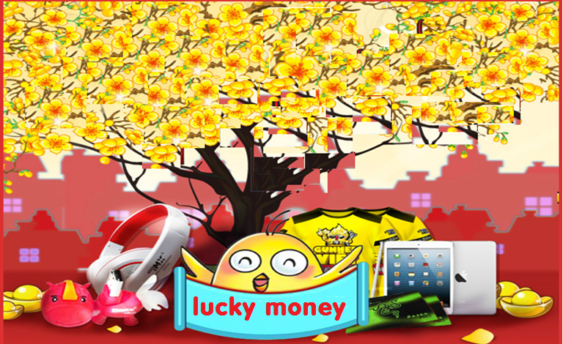

Lucky money
1
3
9
1
5
11
8
6
2
7
10
4
clean the furniture
go to a pagoda
give lucky money
cook special food
decorate the house
buy peach blossoms
watch fireworks

Slide 9

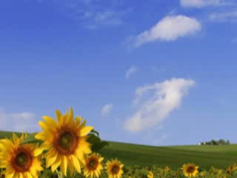

Pronunciation
/ʃ/
Wish
/s/
Spring

Slide 10
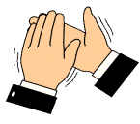

Listen and repeat
/ʃ/ | /s/
Celebrate
School
She
Shopping
Special
Spring
Should
Wish
Blossoms
Summer
Rubbish
Rice
1
2
3
4
5
6
7
8
9
10
11
12

Slide 11


Listen and check
/ʃ/ | /s/
1. We come home every summer.
s
2. We should leave early.
sh
3. I will make a wish.
sh
4. I’m second in my class.
s
ss
sh
5. My mother goes shopping every day.
s
6. This is a small garden.
7. Spring is coming.
S

Slide 12

Listen and check
Spring is coming!
Tet is coming
She sells peach blossoms
Her cheeks shine
Her eyes smile
Her smile is shy
She sells peach blossoms
S
Sh
s
ss
sh
s
s
sh
Sh
s
ss

Slide 13
Choose the best answer
What do you learn today?
Which sounds do you learn?
Which verb often goes with “Fireworks”?
A. New Year | B. Things and activities for Tet | C. Food for Tet holiday | D. Songs about Tet holiday
A. /s/ | B. /z/ | C. /ʃ/ | D. /s/ and /ʃ/
A. cook | B. watch | C. plant | D. clean

Slide 14


HOMEWORK
Learn by heart and write new words 2 lines.
Make 5 sentences with the phrases in EX3 (p.60) textbook.
Do exercises: in Workbook

Slide 15


Slide 16
Best wishes to all of you.
Good bye. See you soon.

Slide 17

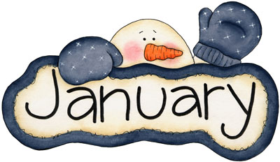
It is the beginning month of a year

Slide 18

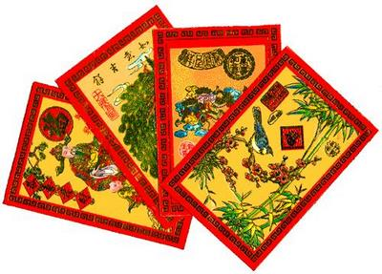

The children like to get from their parents
on Tet holiday for luck.

Slide 19

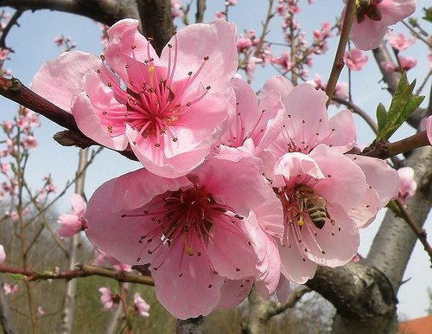
It’s the traditional flower at Tet in Northern of Viet Nam

Slide 20
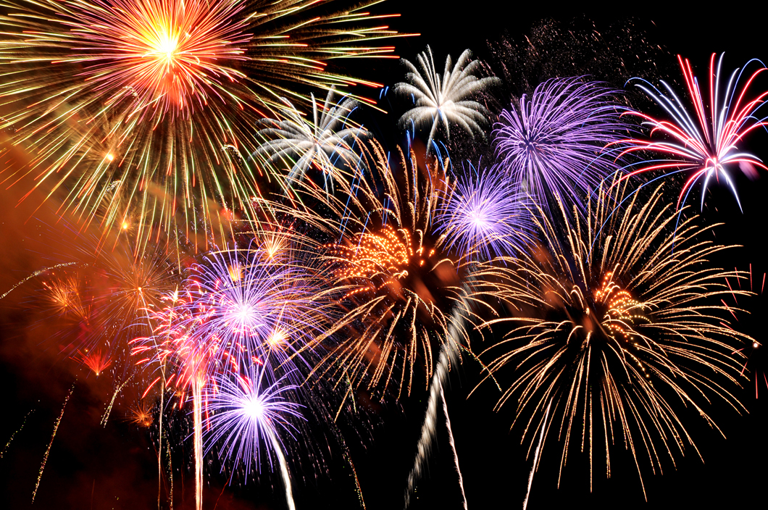
People like to watch them on New Year’s Eve.

Slide 21
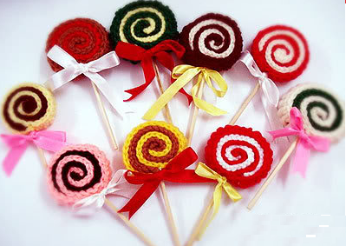
You are so lucky !

Slide 22


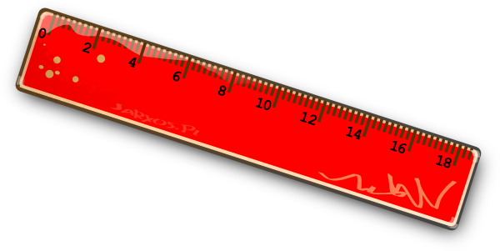
How lucky you are !

Slide 23


Slide 24


